Slide 1
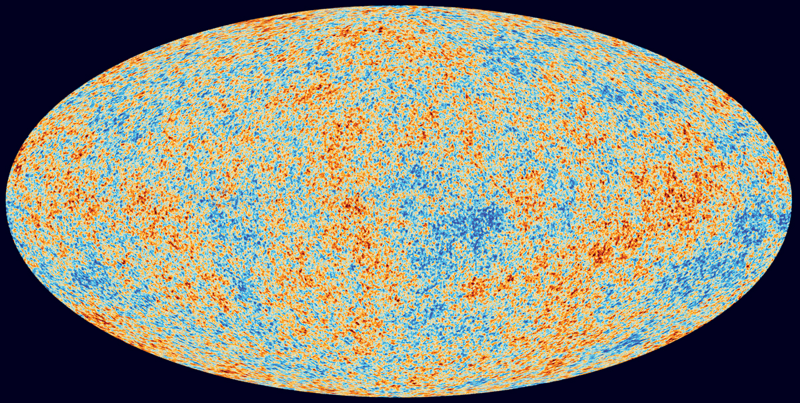

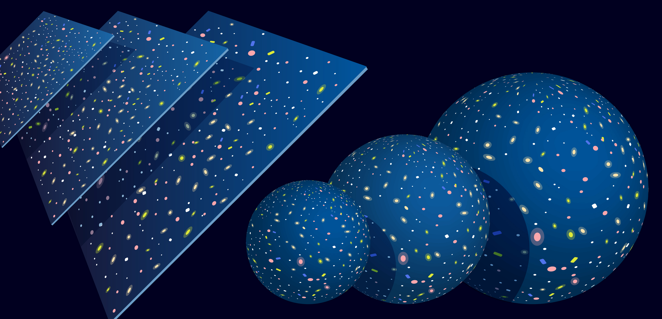
Chronometric Cosmology and the CMBR
Studies on the shape of the universe
Nathan Burwig
Notes:
My goal this summer was to see if one could calculate the temperature of the cosmic microwave background radiation in an alternate universe model

Slide 2
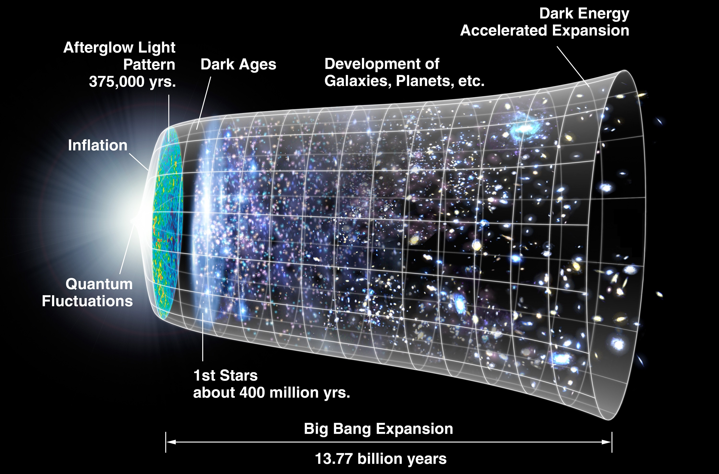
The Current Ideas on Universe Evolution
“Big Bang” Cosmology
Expansion
Flat
Redshift
The CMBR
Hubble
Notes:
Explain the expanding universe model
“Big bang cosmology”
Redshift is used as evidence for the expansion of the universe
CMBR explained as artifact from early hot and dense universe
But this isn’t the only possible explanation
Even Hubble alluded to the possibility of it being a result of a different universe geometry as an explanation for the redshift
Studying if an alternate universe model can explain these phenomenon

Slide 3
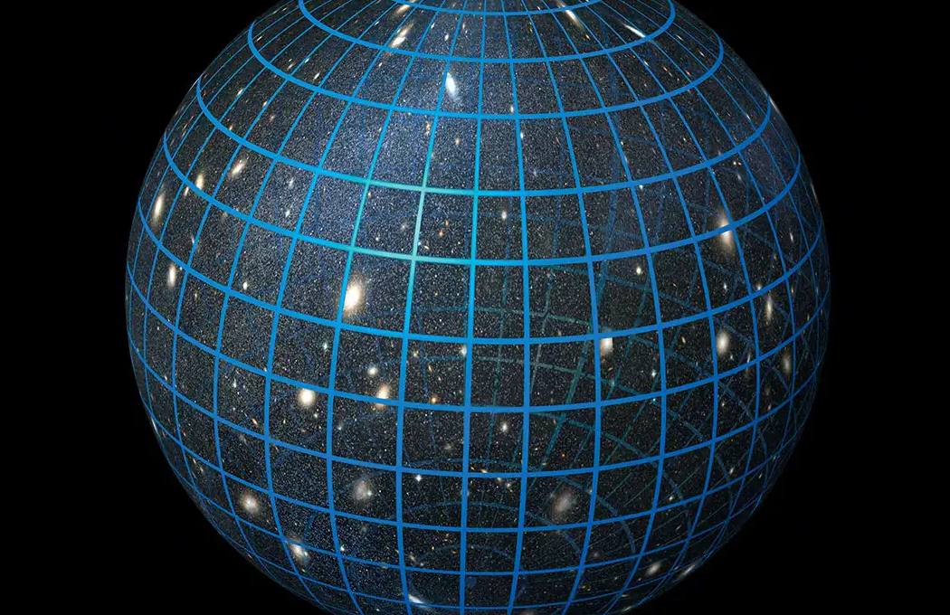
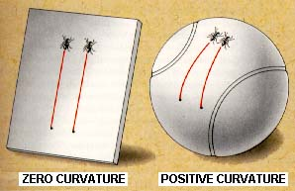
A Different Idea
No need for expansion
Spherical (positive) curvature
Lower dimensional example
Notes:
New model does not require universe expansion
Spherical curvature is unbounded spatially, but finite.
0 curvature is infinite spatially and bounded temporally.
Light could take infinite circuits about the spherically curved universe.
Relate to 2D case
Working in higher dimensions, but that is difficult to think about let alone explain, so we will be using lower dimensional examples to paint nicer pictures

Slide 4
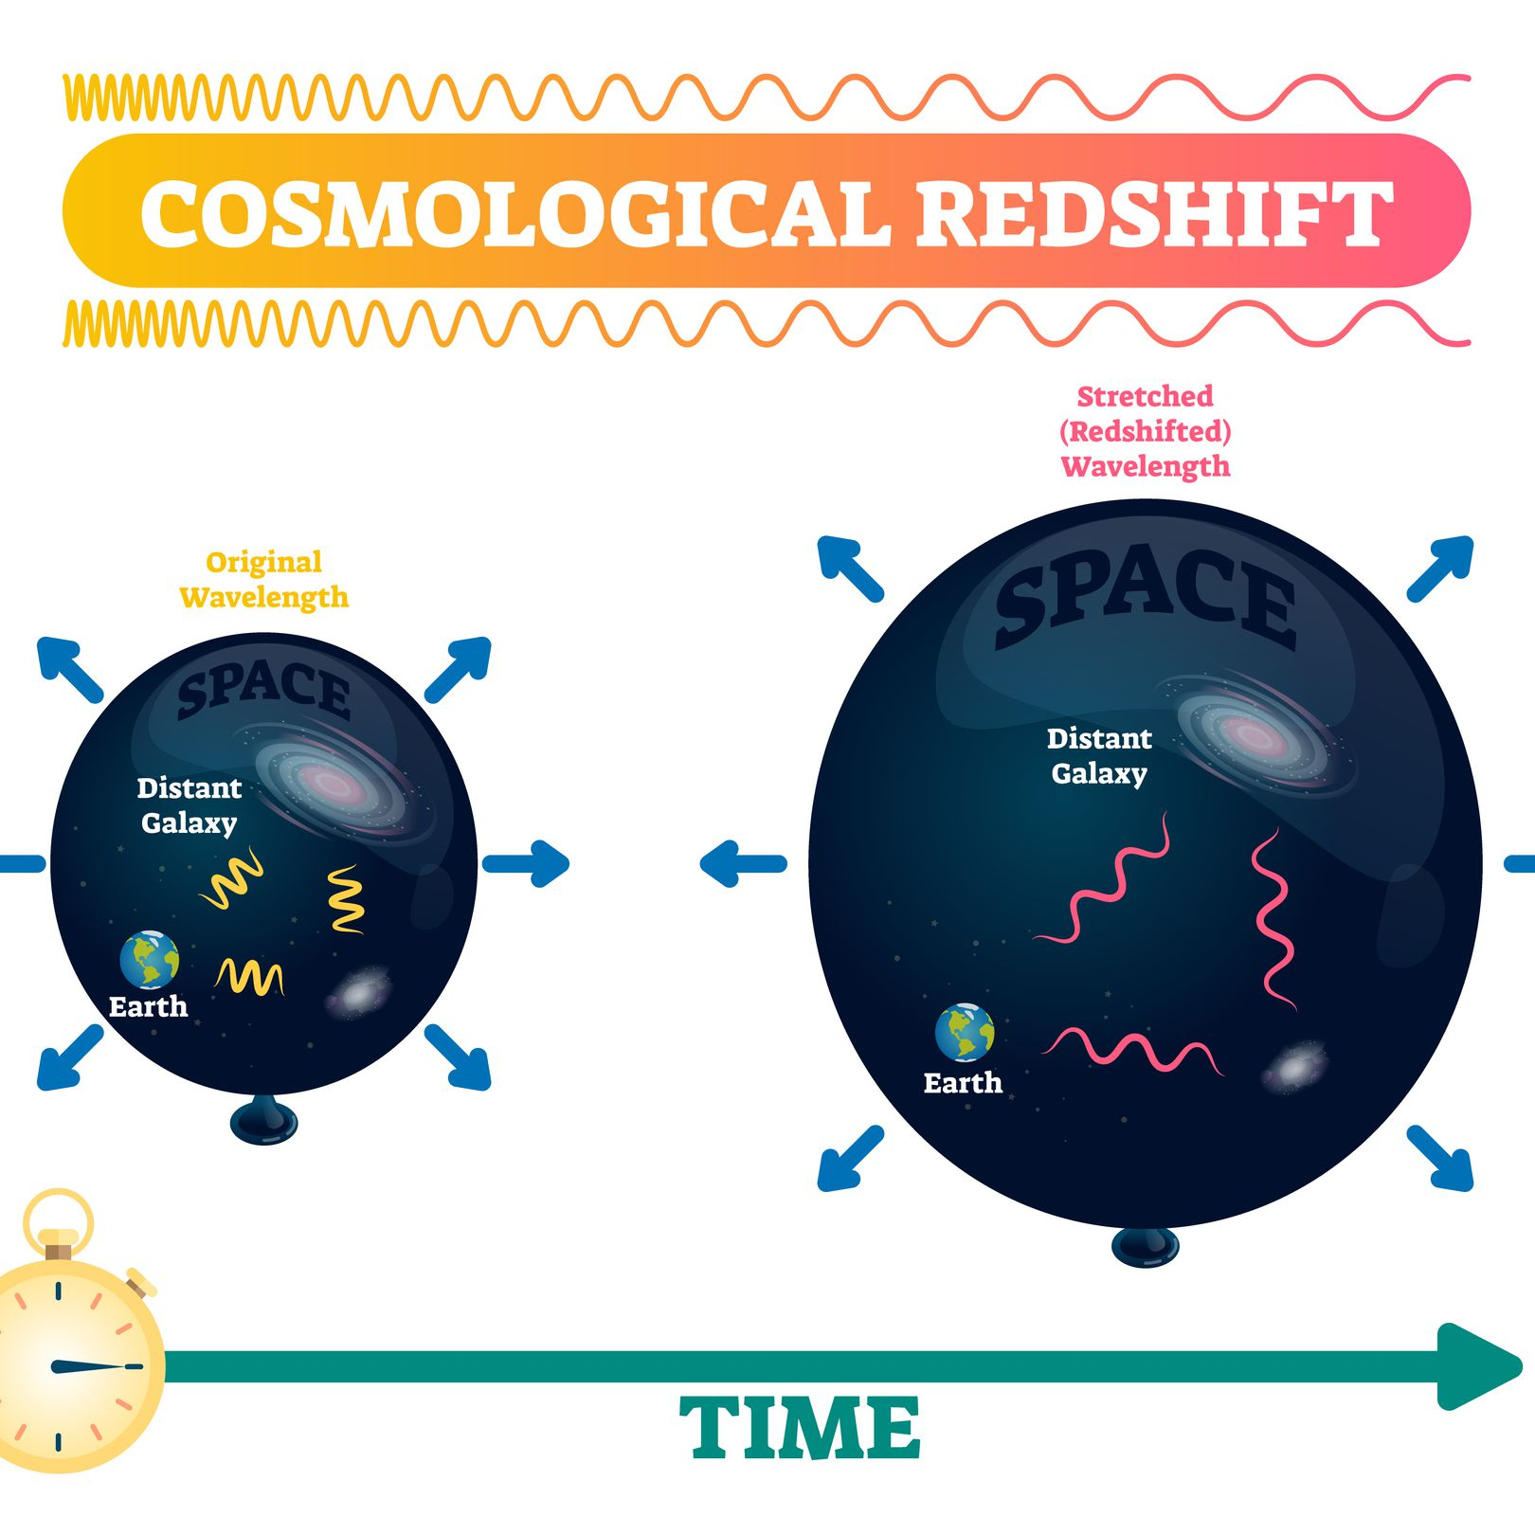
Cosmological Redshift
How they compare between models
Stereographic Projection
Tests for comparing models
Redshift-luminosity relationship
Redshift-number count relationship
Notes:
One of the phenomenon of interest to us is cosmological redshift
Redshift-number count influenced by geometry (homogeneity and isotropy of universe implies number of bodies is related to volume, volume is different in alternate universe geometries.

Slide 5
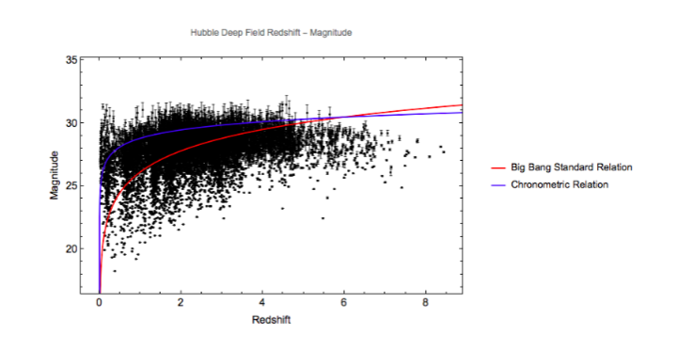
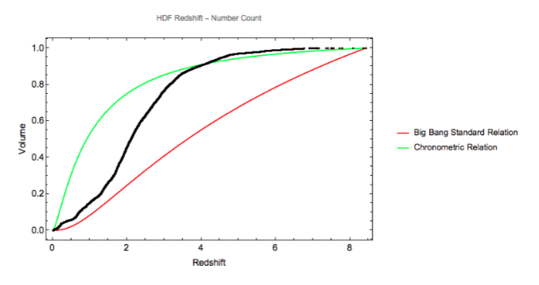
Reasonable Agreement
Redshift relations
Credit – Maxwell Kaye and
Dr. Krzysztof Sliwa
Notes:
HDF has Astro deep which is a subse
Data does not falsify segals model,

Slide 6
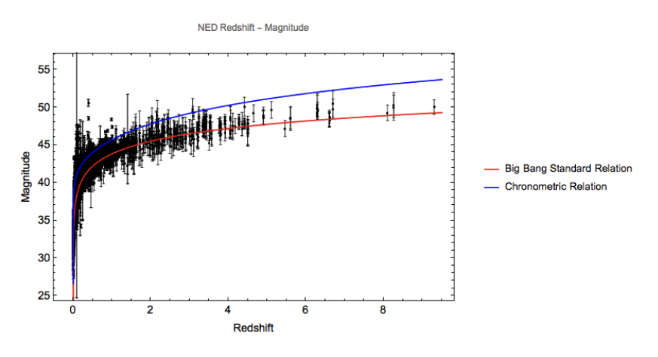
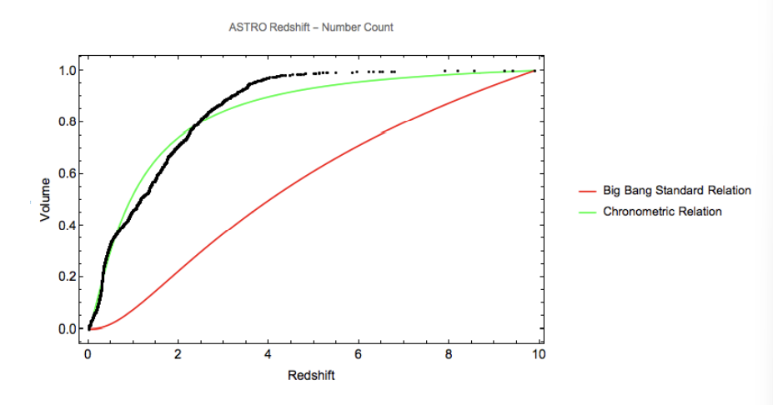
Redshift relations
Credit – Maxwell Kaye and
Dr. Krzysztof Sliwa
Notes:
This indicates that the model has some capacity to explain observed phenomena in modern cosmology
NED looks at almost the whole night sky
Deep field looks at small section
NED masterlist of extragalactic objects, comprehensive sky survey looking at whole sky, not just subsection

Slide 7
The CMBR In Big Bang Cosmology
Nearly Black Body
T = 2.7 K
Light from last scattering
Light from last scattering ~300,000 years

Slide 8
The CMBR In Chronometric Cosmology
Nearly Black Body
T = 2.7 K
Light from last scattering
Light taking circuits about closed universe
How can we determine T in new model?

Slide 9
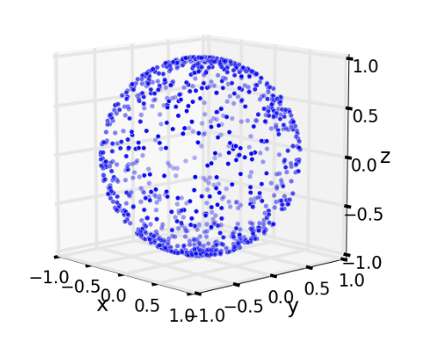
Setting up a model
Points distributed on a sphere (2d case)
The model
Uniformly distribute galaxies
Approximate as absorbing spheres
Light occluded by galaxies
Depends on distance and size
Total average light in the universe

Slide 10
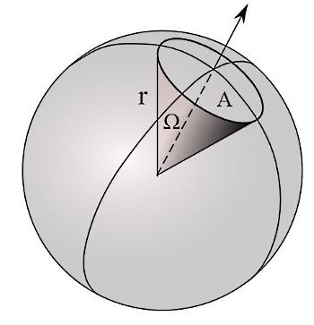

Calculations – Occluded light
Occluded light
Solid angle
$Ω=\frac{πd^{2}}{4πR^{3}Sin^{2}(ρ)} →$ Solid Angle
$Q=\frac{2NSin^{2}\left(ρ\right)}{π} →$ Normalized Volume
$\int_{0}^{π}{QΩ dρ}=\frac{d^{2}N}{2R^{3}} →$ Average light occluded $(γ)$

Slide 11
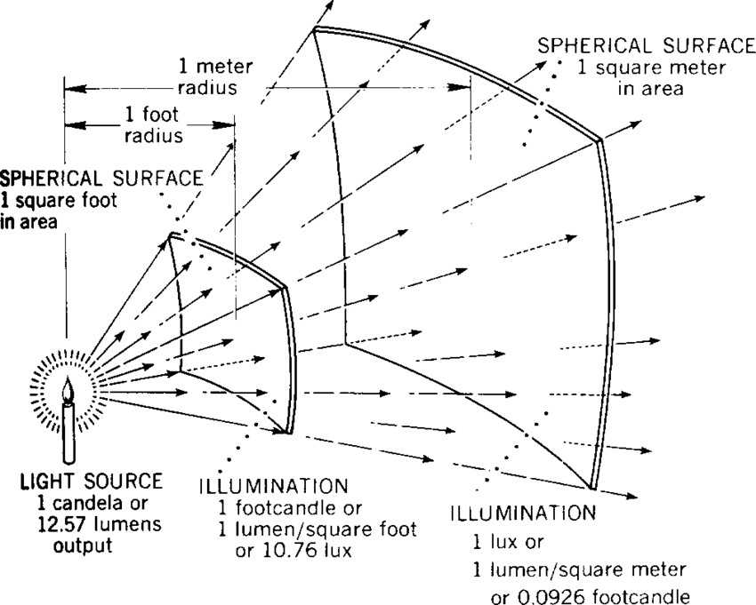

Calculations – Average Light
Luminous flux
Average light in universe
$Φ=\frac{L}{4πR^{3}Sin^{2}(ρ)} →$ Flux of galaxy
$L=πd^{2}φ_{E} →$ Luminosity given milky way
$\int_{0}^{π}{QΦ dρ}=φ_{E}\frac{d^{2}N}{2R^{3}} →$ Avg light in universe $(P)$
Notes:
phiE
Light due to milky way is pristine (unscattered)
Segal model, static universe (nothing changes really) pristine light scatters doesn’t go away, amount of light produced by galaxies remains constant

Slide 12
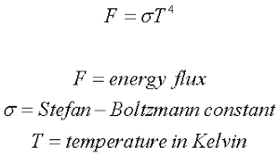


Calculations
Relating the two
Result
Stefan-boltzman
Derive relationship
Probability of absorption
Exponential absorption law
$\frac{P}{γ}$
Notable cancellation
$φ_{E}\frac{\frac{d^{2}N}{2R^{3}}}{\frac{d^{2}N}{2R^{3}}}=φ_{E}$
Relates power to temperature
Notes:
Since prob of absorption depends linearly on the travelled distance (number of half turns), this leads to exponential absorption law

Slide 13


~2.7K (with $\frac{3μW}{m^{2}}$)
2.34K – 2.8K
Notes:
Which shows that this model can explain the observed temperature of the cmbr

Slide 14
Next Steps
More data on flux on Earth
CMBR Power Spectrum

Slide 15
Thank You
Professor Sliwa and Max Kaye
Dr. Anne Moore and Emily Palermo
Summer Scholars Helpers and Presenters

